Slide 1
CHAPTER THREE Multi View Drawing

Slide 2
MULTI-VIEW DRAWINGS
Are convectional projections of a three dimensional object on a two dimensional plane.

Slide 3
LINE CONVENTION
Precedence of coincide lines.
Hidden line drawing.
Center line drawing.

Slide 11
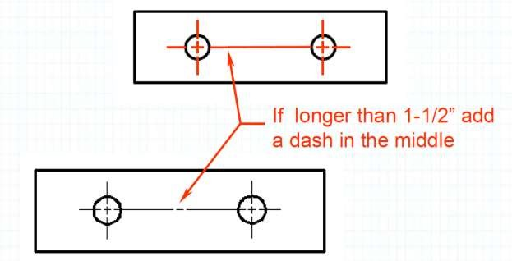
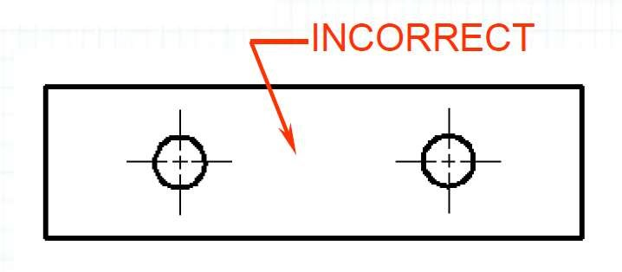

Slide 15
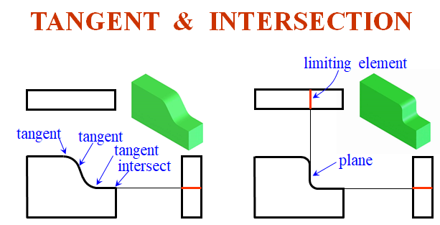

Slide 18
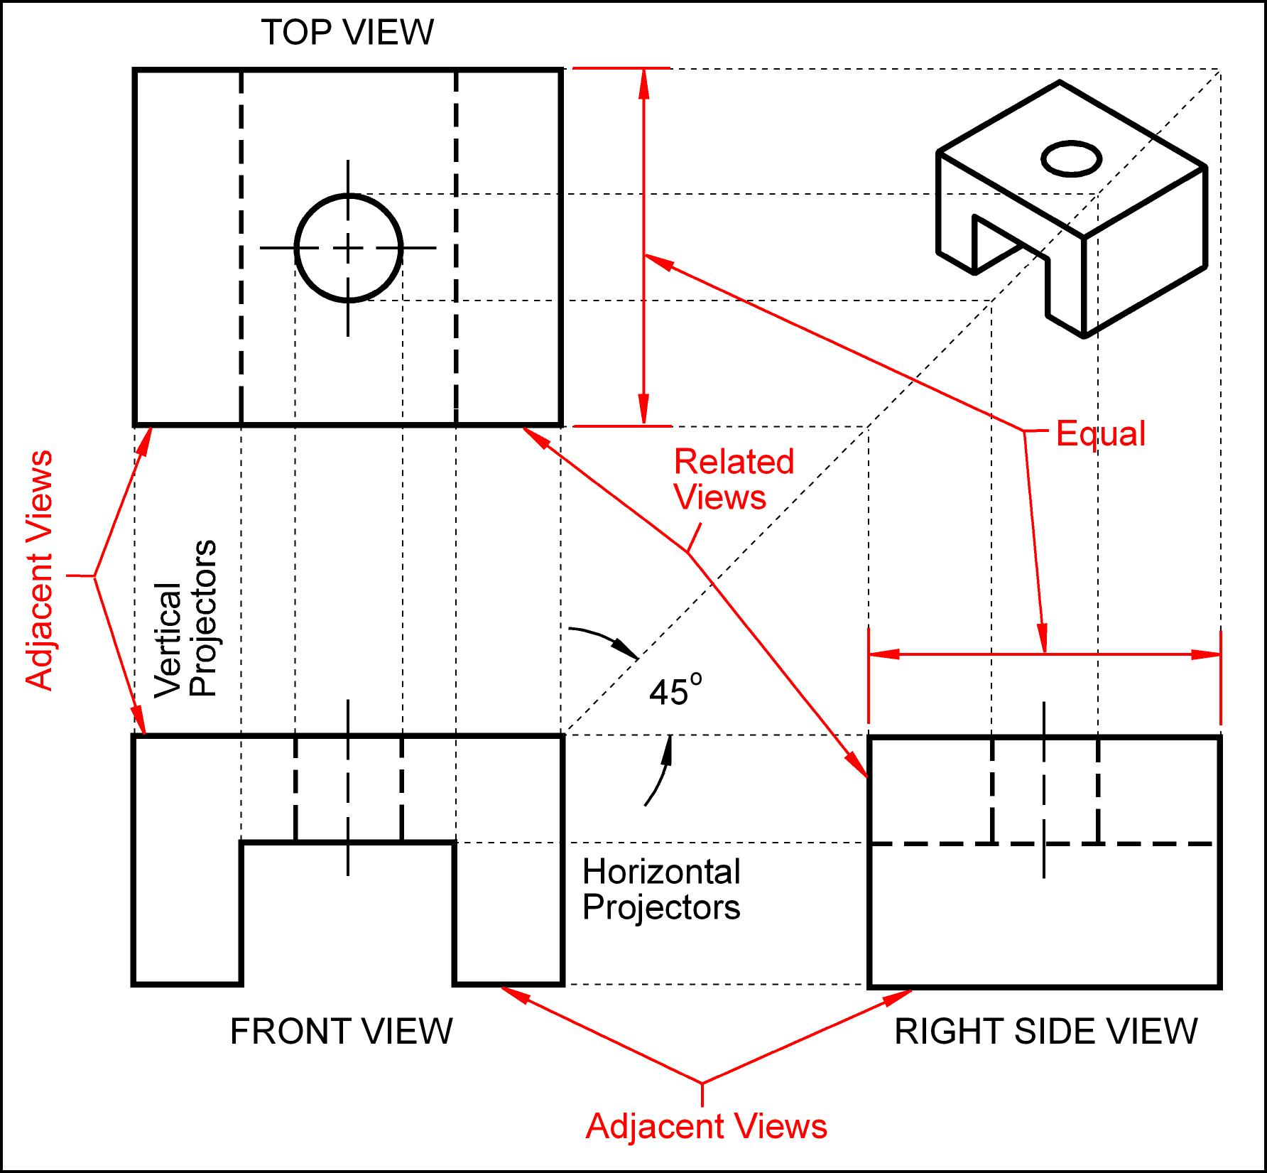

Slide 19
VIEW SELECTION STEPS
1. Orient the object to the best position relative to a glass box.
2. Select the front view.
3. Select adjacent views.

Slide 20
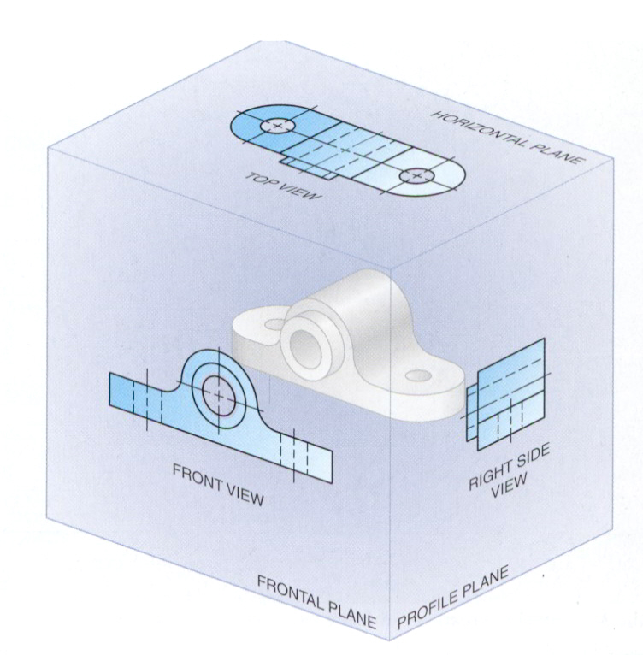
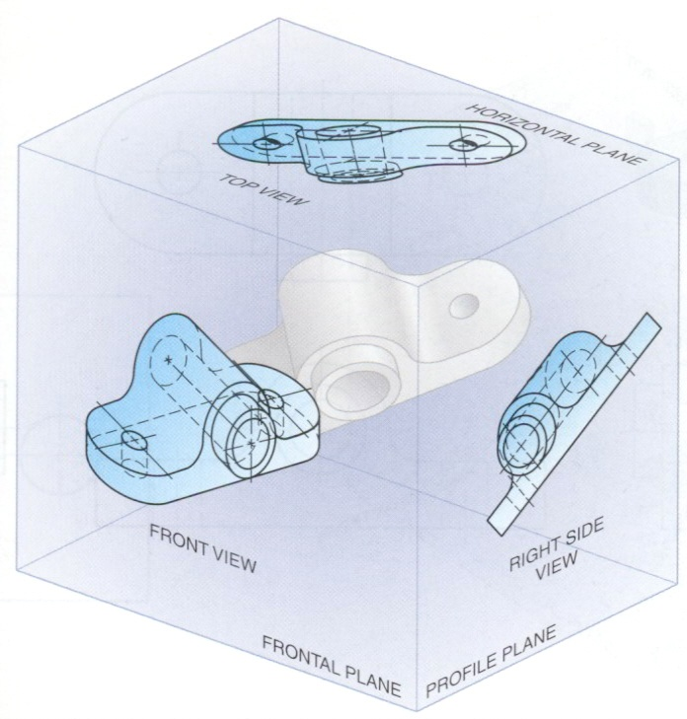
STEP 1 : Orient the Object
The object should be placed in its natural position.
The object should presents its features in actual size and shape in orthographic views.
GOOD
NO !

Slide 21
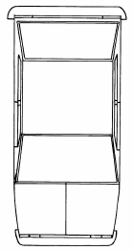
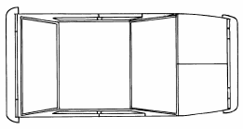
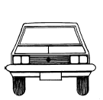
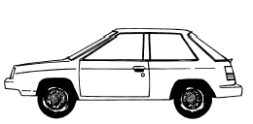
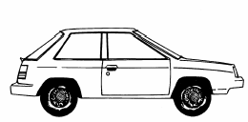
STEP 2 : Select a Front View
The object’s longest dimension should be presented as a width.
First choice
Second choice
Waste more space
Inappropriate
GOOD

Slide 22
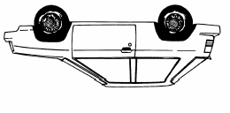
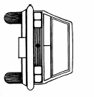
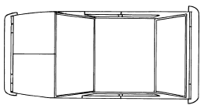
STEP 2 : Select a Front View
The adjacent views that are projected from the selected front view should appear in its natural position.
Inappropriate

Slide 23
STEP 2 : Select a Front View
Choose the view that have the fewest number of hidden lines.
GOOD
Inappropriate

Slide 24
STEP 3 : Select an Adjacent View
Choose the view that have the fewest number of hidden lines.
GOOD
Inappropriate
GOOD
Inappropriate

Slide 25
STEP 3 : Select an Adjacent View
Choose the minimum number of views that can represent the major features of the object.
Hole’s location can be specified on the same view.
Necessary
Easy to understand
Difficult to interprete.
Necessary

Slide 26
STEP 3 : Select an Adjacent View
Choose the views that are suitable to a drawing space.
POOR
Not enough space
for dimensioning.

Slide 27
STEP 3 : Select an Adjacent View
Choose the views that are suitable to a drawing space.
GOOD

Slide 28
Example : View selection
D
mislead to…
H
W
F.V.
W
D
H
F.V. & T.V.
Three views
F.V. & R.S.V.
✓
✓
✓
Size description
✗
✓
✓
Shape description

Slide 29
ONE-VIEW DRAWING
Flat part having a uniform thickness.
1 Thick
Unnecessary
These 2 views provide only information about the part thickness !

Slide 30
ONE-VIEW DRAWING
Cylindrical-shaped part.
Unnecessary
Repeat !
Infer from CL
Unnecessary

Slide 31
TWO-VIEW DRAWING
There exists an identical view.
Repeat !
Unnecessary

Slide 32
TWO-VIEW DRAWING
The 3rd view has no significant contours of the object.
Unnecessary

Slide 33
TWO-VIEW DRAWING
The 3rd view has no significant contours of the object.
Unnecessary

Slide 34
Basic Dimensioning

Slide 35
COMPONENTS
1. Extension lines
10
27
10 Drill, 2 Holes
R16
2. Dimension lines
3. Leader lines
4. Dimension numbers
17
5. Local notes
43

Slide 36
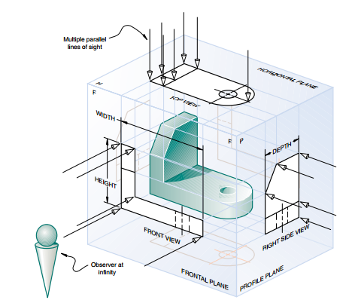

Slide 37
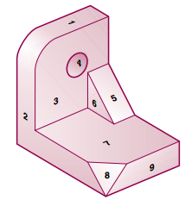

Slide 38
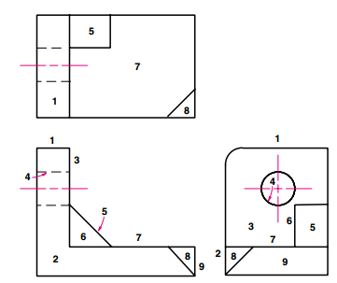

Slide 39
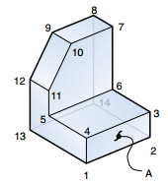

Slide 40
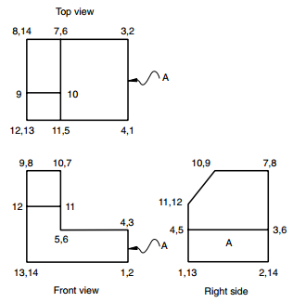

Slide 41
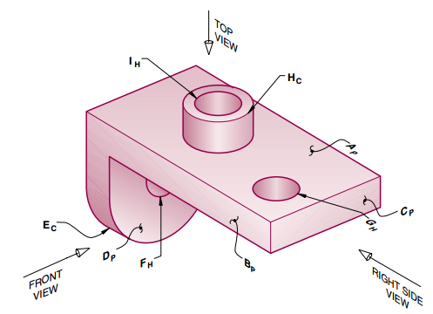

Slide 42
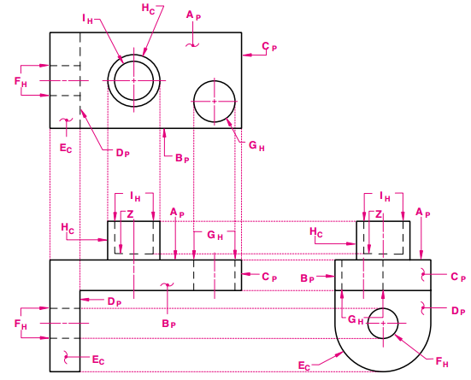

Slide 43
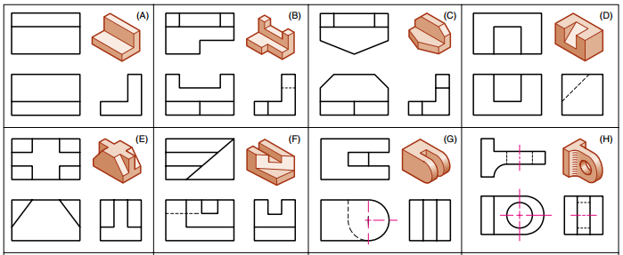

Slide 44
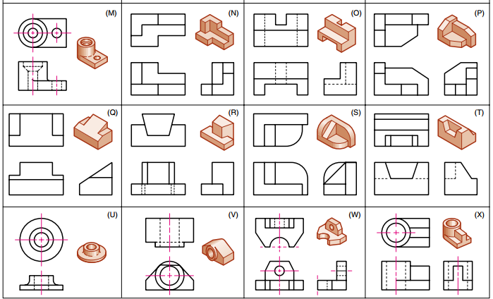

Slide 46
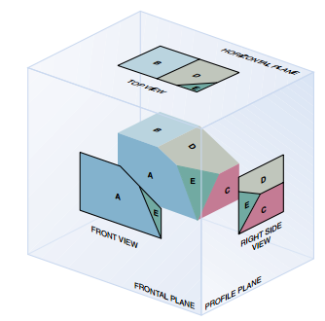

Slide 47
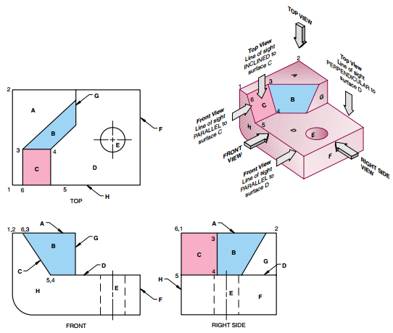

Slide 48
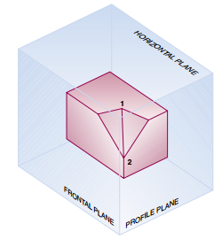

Slide 49
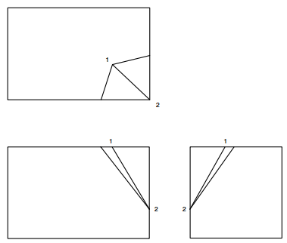

Slide 50
Drawing layout
All three-dimensional objects have width, height, and depth.
Width is associated with an object’s side-to-side dimension.
Height is the measure of an object from top-to-bottom.
Depth is associated with front-to-back distance.

Slide 51
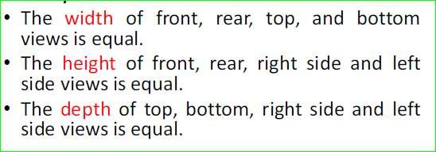
Layout of drawing

Slide 52
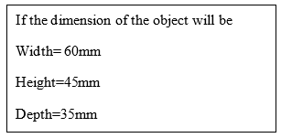
Layout of drawing

Slide 53
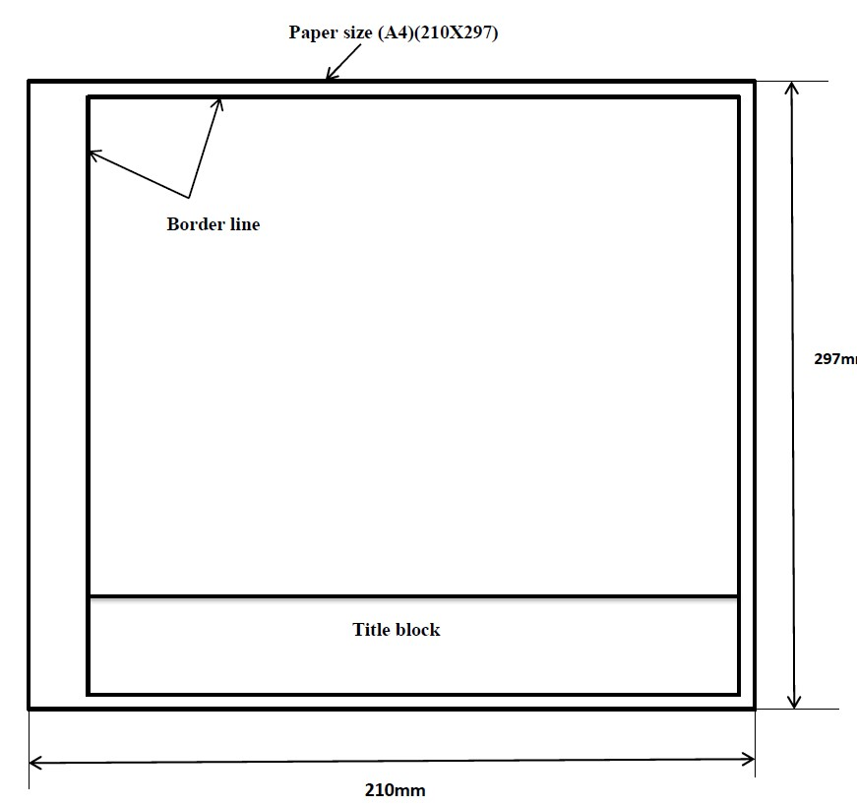
Steps to centering the drawing
Step 1; draw border line and title block.

Slide 54
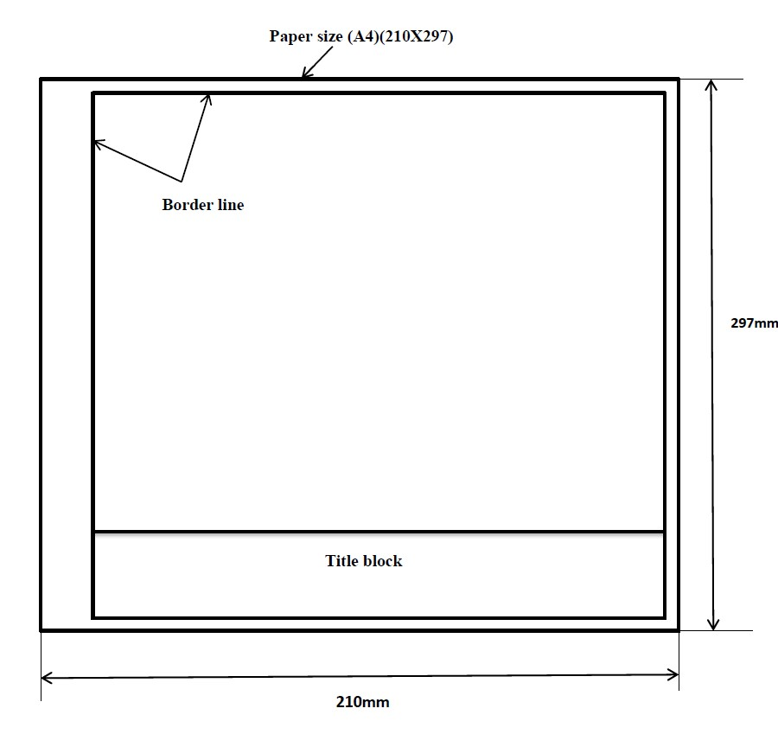
Step 2; draw diagonal lines from the corners of the net working area.
Point of
intersection
Diagonal

Slide 55
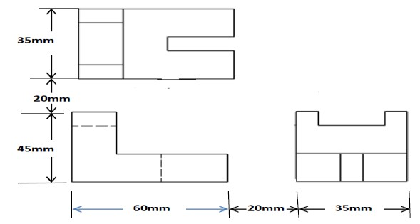
Step 3; calculate the total horizontal and vertical distance covered by the drawing by considering the space between each view.
Top view
Right side
view
Front view
Hint; take 20mm the space between each view
Width
=
60mm
Space
=20
mm
Depth
=
35
mm
Total horizontal =115mm
Height =45mm
Space =20mm
Depth =
35
mm
Total vertical = 100mm

Slide 56
Step 4; draw line from the center (point of intersection of the diagonal lines) to half of horizontal and vertical lines
50
mm
57.5
mm
57.5
mm
50
mm

Slide 57
Step 5; draw the area required for each view.

Slide 58
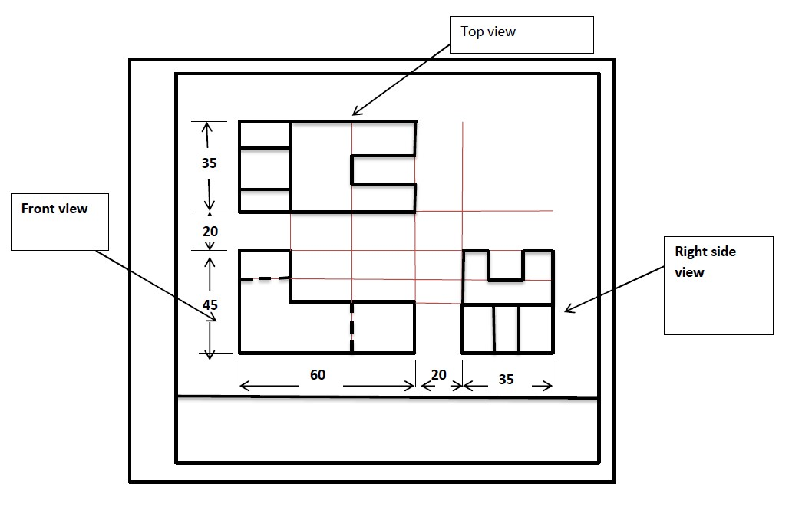
Step 6; draw each view.
Construction
line
Note that; except border line, title block and the views all others can be done by using construction line.

Slide 60
THE END!

